Slide 1
Dance Flow: Personalized Dance Sequence Builder and Scheduler
Dinesha Bungatavula
dlb29@student.le.ac.uk

Slide 2
Aims & Objectives:
The aim of Dance Flow web application is to provide the users with structured and engaging platform helping them to stay organized and improve their dancing skills.
The Admin can add and manage all the dance moves and monitor users.
The users have ability to create their own sequence and practice the sessions according to their preference.

Slide 3
Requirements
Essential:
User authentication
Admin role
Dance moves and sequence creation
Progress tracking
Community features
Recommended:
RBAC
CRUD Operations
Advanced search
Calendar
Notifications
Auto recommendations
Optional:
Profile customization
Offline mode
Voice commands

Slide 4
Technical Stack
Frontend :
HTML5
CSS
JavaScript
Database:
MongoDB
Authentication:
JWT authentication
bcryptjs
Backend:
Node.js
Express.js

Slide 5
Technical Stack
Libraries:
Nodemailer 4. Choices.js
Multer 5. Chart.js
Tui.calendar

Slide 6
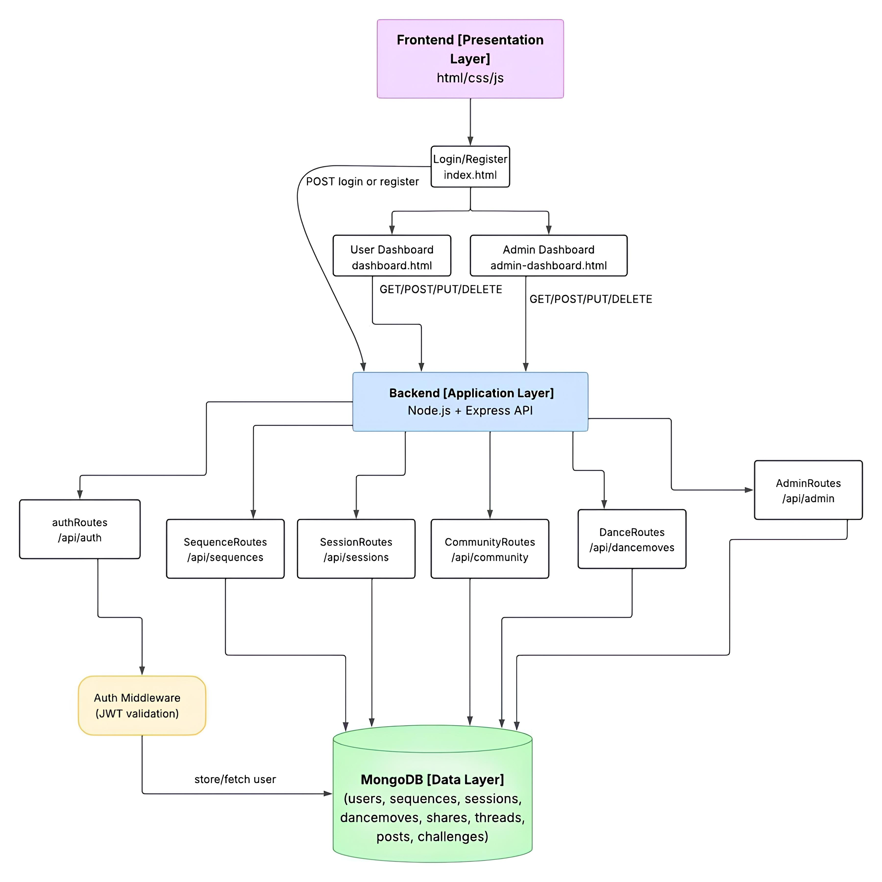
Architecture Diagram

Slide 7
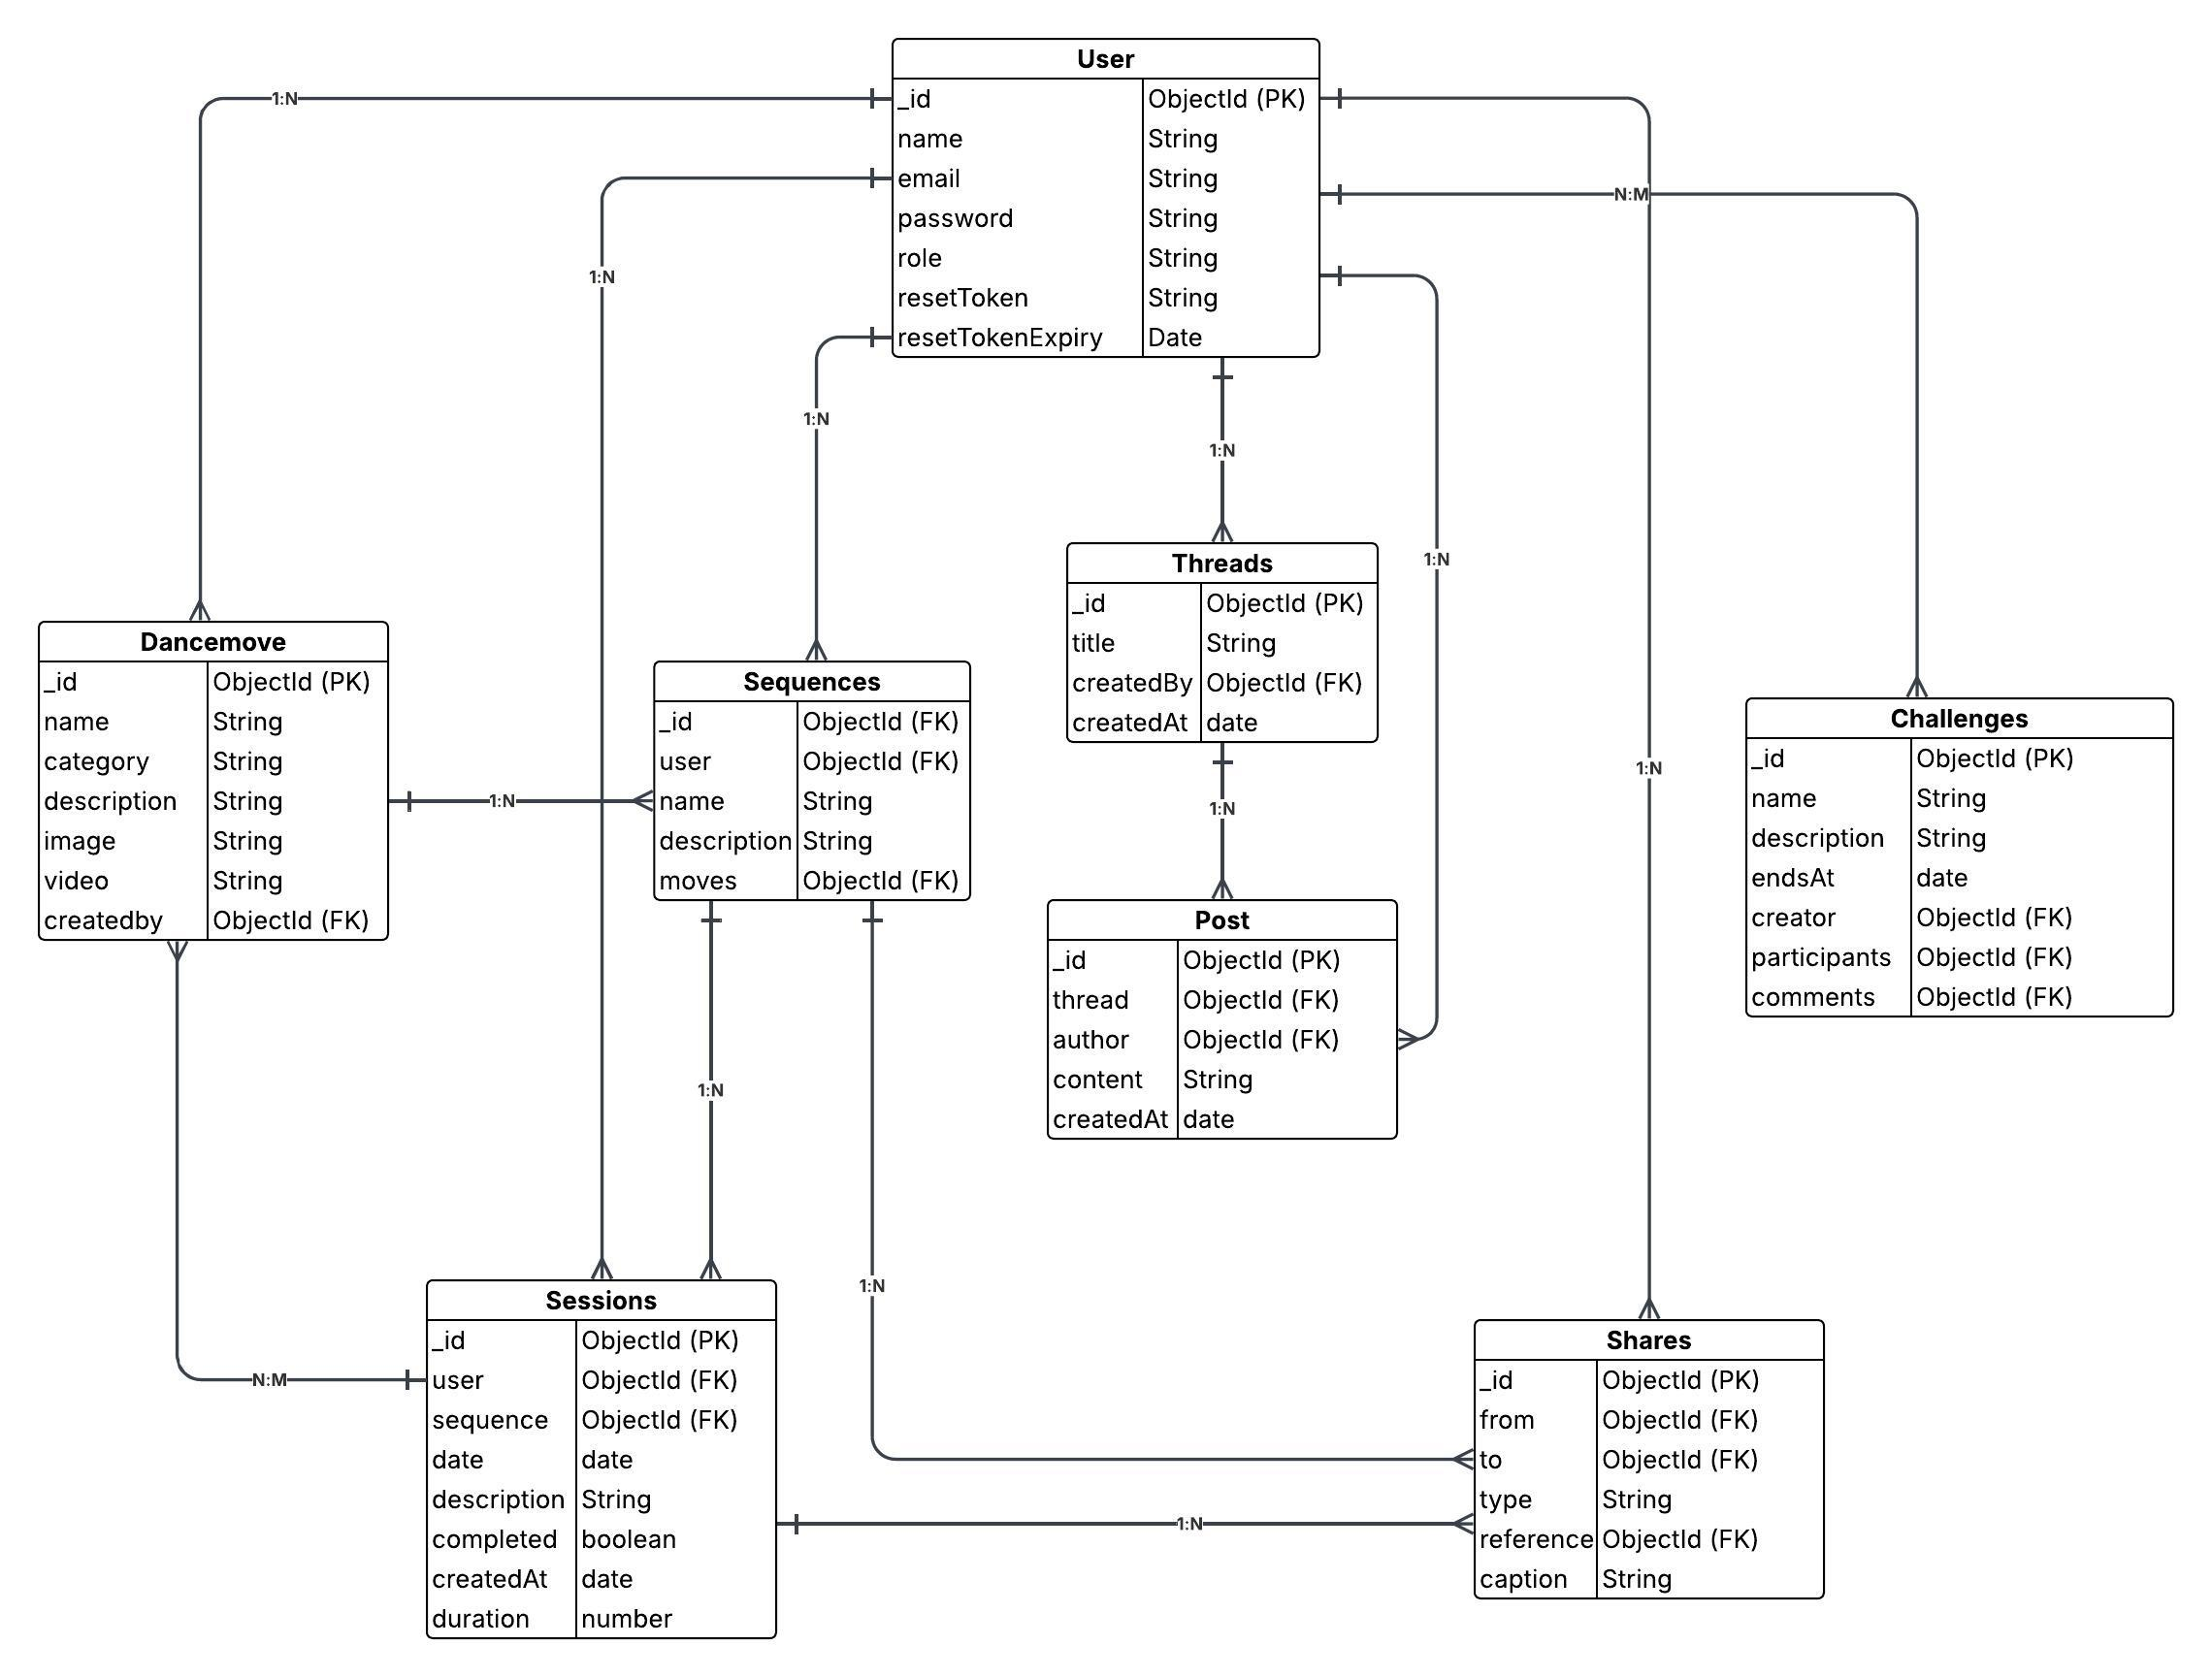
ER Diagram

Slide 8
Challenges faced
Implementing the role-based access.
To integrate the calendar.
To have community space for users.
Outcomes
Fully functional platform.
Clean redirection of user dashboards.
Responsive and interactive calendar.

Slide 9
Thank You

